Slide 1
Novel Support Vector Machines for Diverse Learning Paradigms
Gabriella Melki, PhD. Candidate, Virginia Commonwealth University
Advisor: Dr. Alberto Cano
Assistant Professor
Virginia Commonwealth University
Advisor: Dr. Sebastián Ventura
Professor
University of Córdoba
Notes:
Thank the committee for being here
Thank others as well
Today I'll present our current work + proposal for future work for my final phd dissertation which is based on developing novel svm…

Slide 2
Agenda
Introduction and Motivation
Multiple-Target Learning
Multiple-Instance Learning
Background
Support Vector Classification
Support Vector Regression
Multi-Target SVR using Maximum Correlation Chains
Novel SVMs for MT Regression
Experimental Environment
Results & Statistical Analysis
MTR Conclusions
Multi-Instance SVM using Bag Representatives
Novel SVM for MI Classification
Experimental Environment
Results & Statistical Analysis
MIL Conclusions
Conclusions
Future Work
Publications
Notes:
The structure of the talk will be as follows

Slide 3
Motivation
Introduction & Motivation
Over the past decade, dataset sizes have grown disproportionately to the speed of processors and memory capacity, limiting machine learning methods to computational time.
More recently, these traditional methods have been extended to accommodate various types of data paradigms:
Multiple-Target Learning (MTL)
Multiple-Instance Learning (MIL)
Our MTR and MIL proposals aim to deal with these drawbacks that exist in both paradigms using Support Vector Machines.
Notes:
What is the motivation for the line of research?
For traditional machine learning, it stems from the tell-all case of solving large learning problems in a timely fashion
Because dataset sizes have been growing so rapidly, we need to develop machine learning algorithms that are able to extract all the knowledge possible in a timely fashion.
More recently, traditional learning problems and methods have been extended to accommodate various emerging data representations which have given rise to new learning paradigms such as MTL and MIL.
Our contributions aim to tackle these two fundamental problems while remedying the drawbacks of current methods that exist
Before going into details how we tackled these problems, I’d like to provide a brief description of the two paradigms mentioned.

Slide 4
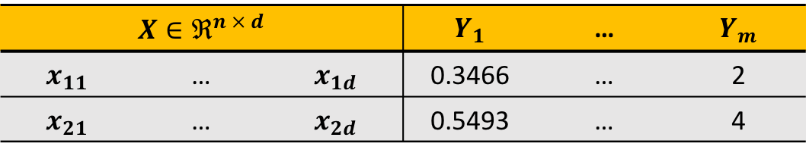
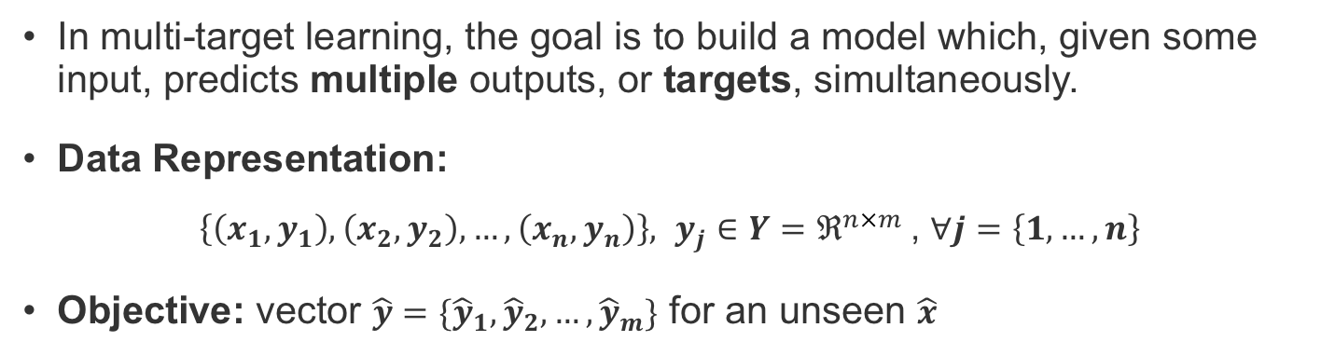
Multiple-Target Learning
Introduction & Motivation
In multi-target learning, the goal is to build a model which, given some input, predicts multiple outputs, or targets, simultaneously.
Data Representation:
$\left\{\left(x_{1}, y_{1}\right),\left(x_{2}, y_{2}\right),…,\left(x_{n}, y_{n}\right)\right\}, y_{j}∈Y=ℜ^{n×m}$, $∀j=\left\{1, …, n\right\}$
Objective: vector $\hat{y}=\{{\hat{y}}_{1}, {\hat{y}}_{2}, …, {\hat{y}}_{m}\}$ for an unseen $\hat{x}$
$$X∈ℜ^{n × d}$$ |  |  | $$Y_{1}$$ | … | $$Y_{m}$$
$$x_{11}$$ | … | $$x_{1d}$$ | 0.3466 | … | 2
$$x_{21}$$ | … | $$x_{2d}$$ | 0.5493 | … | 4
Notes:
First, we’ll begin with multiple target learning
Multi-target learning is a challenging task that consists of creating predictive models for problems with multiple outputs
So, each sample is associated with more than a single output, or target (describe the data example)
Since the targets are produced by the same system, this implies that they might be correlated
Many types of multi-target
Multi-label classification
Multi-target regression
For the purpose of this work, we focus on MTR

Slide 5
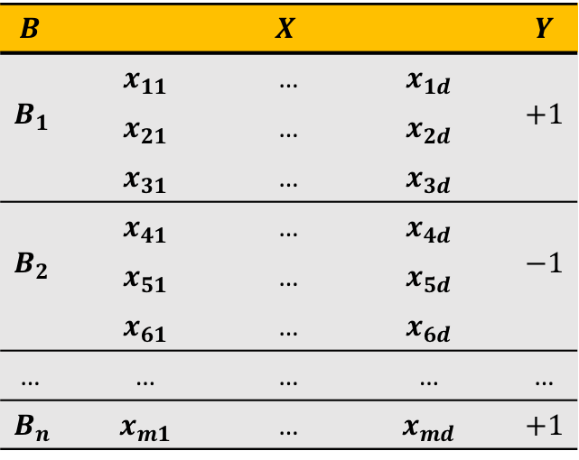
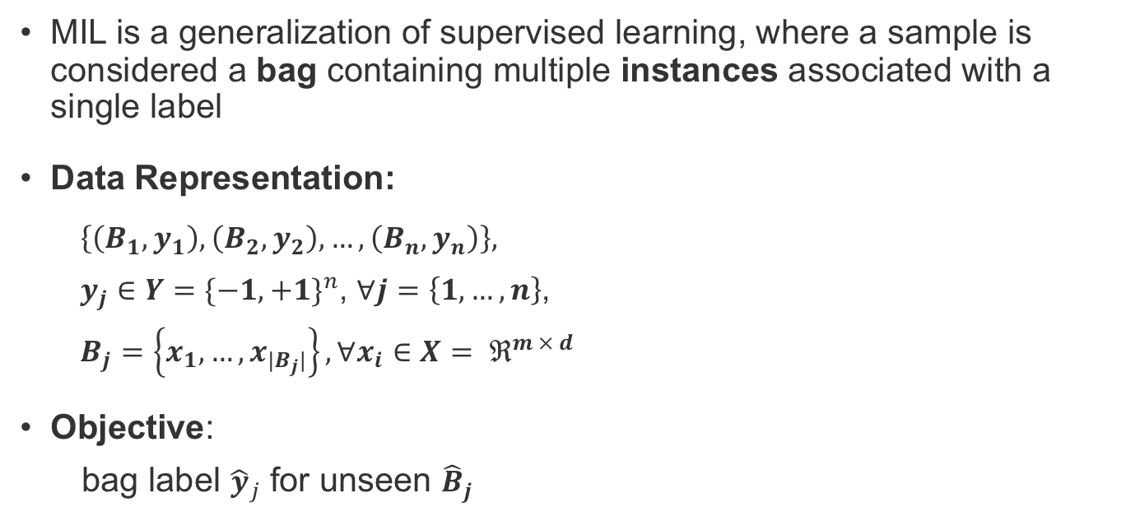
Multiple-Instance Learning
Introduction & Motivation
MIL is a generalization of supervised learning, where a sample is considered a bag containing multiple instances associated with a single label
Data Representation:
$\left\{\left(B_{1}, y_{1}\right),\left(B_{2}, y_{2}\right),…,\left(B_{n}, y_{n}\right)\right\},$
$y_{j}∈Y={\{−1,+1\}}^{n}$, $∀j=\left\{1, …, n\right\}$,
$B_{j}=\left\{x_{1}, …,x_{|B_{j}|}\right\}, ∀x_{i}∈X= ℜ^{m × d}$
Objective:
bag label ${\hat{y}}_{j}$ for unseen ${\hat{B}}_{j}$
$$B$$ | $$X$$ |  |  | $$Y$$
$$B_{1}$$ | $$x_{11}$$ | … | $$x_{1d}$$ | $$+1$$
 | $$x_{21}$$ | … | $$x_{2d}$$
 | $$x_{31}$$ | … | $$x_{3d}$$
$$B_{2}$$ | $$x_{41}$$ | … | $$x_{4d}$$ | $$−1$$
 | $$x_{51}$$ | … | $$x_{5d}$$
 | $$x_{61}$$ | … | $$x_{6d}$$
… | … | … | … | …
$$B_{n}$$ | $$x_{m1}$$ | … | $$x_{md}$$ | $$+1$$
Notes:
MIL is a generalization of super...
The instances in the bag are somehow related
We don't know the Individual labels within the bag - this makes it a form of semi-supervised learning
The only label that we know is the bag label - the way this label is assigned is dictated by some MI- Assumption
Describe the data
Given these two learning paradigms, we now move on to our contributions

Slide 6
Contributions
Introduction & Motivation
3 Novel Multi-Target Support Vector Regressors
Novel Multi-Instance SVM using Bag Representatives (MIRSVM)
SVR with problem transformation
SVRRC, an ensemble of randomly chained SVRs
SVRCC, a chained SVR using a maximum correlation chain
Reformulating the L1 SVM problem to optimize over bags
Dual SVM formulation using bags
A unique bag-representative selection method
Notes:
Our contributions are twofold.
For the MTL paradigm, we approached the specific problem of MTR and we present...
For the MIL paradigm, we present
These contributions consist of both classification and regression problems, which can be solved by minimizing some sort of risk. The risk is defined as the loss incurred by our classifier function, with some regularizer in order to generalize the model. In our case, the Risk we want to minimize is that of the SVM problem.

Slide 7
Background
Notes:
Now, I’d like to give a short background on SVMs in the context of both classification and regression

Slide 8
Support Vector Classification
Background
The goal:
margin
SVM problem:
Hinge-loss:
Notes:
Support vector machines (SVM), represent popular linear and non-linear (kernelized) learning algorithms based on the idea of a large-margin classifier.
SVMs are similar to other machine learning techniques, but literature shows that they usually outperform them in terms of scalability, computational efficiency, and robustness against outliers.
They are known for creating sparse and non-linear classifiers, making them suitable for handling large datasets.
The goal of SVC is to learn a classifier f(x), that maximizes the margin of separability between classes while minimizing the loss or error. In this case, the error is the hinge loss function, which is key to the SVMs model sparsity.
[SHOW ANIMATION] The margin is maximized by minimizing the norm of w. This is because the size of the margin is inversely proportional to the norm of w.
Here C controls the tradeoff of margin maximization and error minimization.

Slide 9
Using Kernels
Background
To handle cases where data are non-linearly separable, while enhancing the classifiers capabilities, a kernel function can be used:
The advantage of utilizing kernels is being able to calculate the inner product in the input space rather than in the very high feature dimensional space.
Notes:
The SVM problem can kernelized to account for non-linearly separable data by using a kernel function where the feature space is mapped to a higher dimensional space,
Here, φ(·) represents that mapping function
The advantage of utilizing kernels is being able to calculate the inner product in the input space rather than in the very high feature dimensional space
The SVM model output, o, for a given input vector x is defined by the kernel, is given by.. where α are the coefficients, or weights, of the expansion in feature space, and b ∈ R is the so-called bias term.
A model is called dense if the absolute value of all its weights are greater than 0, while a sparse model would be one that contains some αi = 0. The level of sparseness may vary, but the sparser the model, the more scalable the applications.

Slide 10
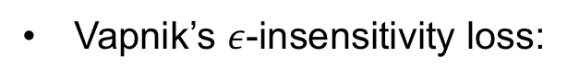
Support Vector Regression
Background
SVR problem:
Vapnik’s $ε$-insensitivity loss:
Notes:
The support vector machine was applied to the regression case, maintaining all the maximal margin algorithmic features.
the goal is to learn a function f(x) with at most ε deviation from the true targets yi for all the training data, while being as flat as possible. This was introduced by Vapnik’s linear loss function with ε-insensitivity zone,
The loss is equal to 0 if the difference between the predicted and true output values is less than ε.
I.E. If the predicted value is within the tube, no loss is incurred
Now that we’ve introduced the SVM classification and regression problems, this brings us to how to solve them.

Slide 11
Solving the SVM Problem
Background
Quadratic Programming (QP) Solvers:
Interior Point Method
Sequential Minimal Optimization (SMO)
Geometric methods:
Core Vector Machines (CVM)
Ball Vector Machines (BVM)
Minimum Norm SVM (MN-SVM)
Descent methods:
Non-Negative Iterative Single Data Algorithm (NNISDA)
Naïve Online R Minimization Algorithm (NORMA)
Primal Estimated sub-Gradient SOlver for SVM (PEGASOS)
OnLine Learning Algorithm (OLLA)
Notes:
Although support vector machines represent a major development in machine learning algorithms, in the case of large-scale problems (hundreds of thousands to several millions of samples), the design of SVM training algorithms still has room for improvement.
Traditional QP solvers can be used but they explode with the number of samples
SMO is by far the most popular and widely used method for solving both classification and regression, but it is highly dependent on the SVM hyperparameters.
Geometric solvers include, such as MN-SVM, BVM, and CVM, however MNSVM has been shown to outperform the popular BVM, CVM, and SMO methods.
More recently, descent methods (coordinate or stochastic) have been used because of their sub-linear convergence.
Given these popular solvers, we opted to take the SVM and apply it to the emerging learning paradigms mentioned previously.

Slide 12
Multi-Target SVR using Maximum Correlation Chains
G. Melki et al. “Multi-target support vector regression via correlation regressor chains”. Information Sciences, vol. 415, pp. 53–69, 2017.
Notes:
Now, we will present our 3 contributions for the multi-target regression learning paradigm based on the idea of building chained regressors.
First, I'll give a brief background on some methods for solving this paradigm, then we will dive into the technicalities of my proposals

Slide 13
Multiple-Target Learning
Multi-Target SVR using Maximum Correlation Chains
Problem Transformation vs Algorithm Adaptation
Linear Target Combinations for MT Regression
Multi-Objective Random Forests (MORF)
Classifier Chains:
RC, MTS, MTSC, ERC, and ERCC
Two stages of iterative learning:
Building single-target model on the next chain component
Use the knowledge gained by the previous component to predict the next target in the chain, while using possible relationships the targets might have with one another.
G. Melki et al. “Multi-target support vector regression via correlation regressor chains”. Information Sciences, vol. 415, pp. 53–69, 2017.
Notes:
There are two main approaches to multi-target learning, problem transformation and algorithm adaptation.
Problem transformation methods involve altering the MT problem into ST ones.
Algorithm adaptation methods involve modifying existing traditional algorithms to predict all the target variables simultaneously.
It is known that algorithm adaptation methods outperform problem transformation methods. The most valuable advantage of using AA is that, not only are the relationships between the sample variables and the targets exploited, but the relationships between the targets amongst themselves are as well.
One approach for AA in the context of classification are the idea of classifier chains
Examples of these include...
Chaining usually involve 2 stages:
Building an ST model
Using knowledge gained by first step to predict remaining targets, while using correlations.
We decided to utilize this chaining idea and apply it to regression using SVRs
Although these methods seem similar in nature, there are fundemental differences

Slide 14
Multi-Target SVR
Multi-Target SVR using Maximum Correlation Chains
G. Melki et al. “Multi-target support vector regression via correlation regressor chains”. Information Sciences, vol. 415, pp. 53–69, 2017.
Notes:
The base model is the SVR model, where m single-target non-linear support vector regressors (NL-SVR) are built for each target variable Yj
Describe figure
The reason behind this method:
Evaluate the performance of ST-SVM against the other SOA methods
Evaluate it as a base-line method for the purpose of observing the improvements of our chained methods against a ST method

Slide 15
SVR with Random Chains (SVRRC)
G. Melki et al. “Multi-target support vector regression via correlation regressor chains”. Information Sciences, vol. 415, pp. 53–69, 2017.
Notes:
This brings us to our second contribution, inspired by ERCC, SVRRC.
Describe
Here the dataset is not split, but rather the model is adapted to the various target outputs
The adaptation stems from model chaining
So, what constitutes building a chained model?
Describe using the figure
[Difference between us and ERCC]
In ERCC, their chained model consists of chaining the predicted target values from the previous step, for SVRRC, we opted against that and used the true target outputs in order to minimize error propagation during the chaining process
This method was fine, but we worried that that randomly generated chains might not maximally capture the target’s correlations. That brings us to our next proposal.
4 targets > 10 chains

Slide 16
SVR max-Correlation Chain (SVRCC)
G. Melki et al. “Multi-target support vector regression via correlation regressor chains”. Information Sciences, vol. 415, pp. 53–69, 2017.
Notes:
This contribution builds a single chained regressor in the direction of maximum correlation among the target variables
The idea behind this is to build a single chain that captures the targets correlations properly
This ensures that using the target as input for the next positively contributes towards learning
We first calculate the correlation coefficient matrix for the target variables,
take the row-wise sum of absolute value,
sort them in decreasing order, and
use the indices as the max-corr chain

Slide 17
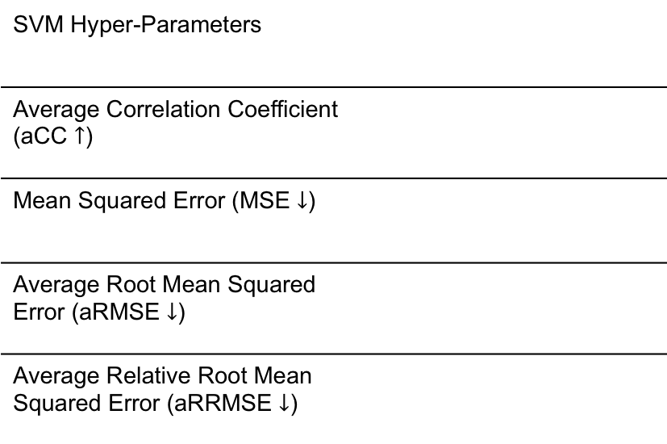
Experimental Environment
Multi-Target SVR using Maximum Correlation Chains
SVM Hyper-Parameters
Average Correlation Coefficient (aCC $↑$)
Mean Squared Error (MSE $↓$)
Average Root Mean Squared Error (aRMSE $↓$)
Average Relative Root Mean Squared Error (aRRMSE $↓$)
G. Melki et al. “Multi-target support vector regression via correlation regressor chains”. Information Sciences, vol. 415, pp. 53–69, 2017.
Notes:
Algorithm comparison with the popular methods mentioned previously because framework is readily available: RC, ST, MTS, MTSC, ERC, ERCC, and MORF
Developed our novel SVRs in MULAN’s framework of MTRgressor, which was built on top of weka. and used the recommended parameters for each of the methods compared
The following are the metrics used
rigorous statistical analysis was performed as well but for the sake of time, we will only report the bonf-dunn with critical difference value with 95% confidence
The ST base-line model used was Bagging of 100 regression trees.
The MTSC and ERCC methods are run using 10-fold cross-validation, and the ensemble size for the ERC and ERCC methods was set to 10.
The ensemble size of 100 trees was used for MORF, and the rest of its parameters were set as recommended by Kocev et al. “Tree ensembles for predicting structured outputs”. In: Pattern Recognition 43 (2013), pp. 817–833.

Slide 18
Results
Multi-Target SVR using Maximum Correlation Chains
G. Melki et al. “Multi-target support vector regression via correlation regressor chains”. Information Sciences, vol. 415, pp. 53–69, 2017.
Notes:
All proposals 17 out of the 24 datasets
SVR performs the best on 1 / 17
SVRRC 5 / 17
SVRCC performs the best on 11 / 17
These results complement our initial hypothesis that chaining does in fact improve the performance of the classifier

Slide 19
Results
Multi-Target SVR using Maximum Correlation Chains
G. Melki et al. “Multi-target support vector regression via correlation regressor chains”. Information Sciences, vol. 415, pp. 53–69, 2017.
Notes:
Here the results indicate that the ST methods are the fastest, which makes sense because they are neither ensembles nor chained classifiers.
Talk about how SVRCC is competitive against the ST methods
Not only is it competitive in terms of performance, but it is also competitive in terms of time

Slide 20
MTR Conclusions
Multi-Target SVR using Maximum Correlation Chains
Results show the superior performance of using the SVR method as a base-line model, rather than regression trees as used in MORF.
SVRRC’s results highlighted the importance exploiting relationships among the target variables during training.
The results show the superiority of using the SVRCC method:
Ranked the best in all quality metrics and second best in terms of run time.
SVRCC performed better than the two other contributions proposed
This shows that the targets’ maximum correlation does positively contribute toward model training
Significant differences exist between the proposed algorithms against the methods compared.
G. Melki et al. “Multi-target support vector regression via correlation regressor chains”. Information Sciences, vol. 415, pp. 53–69, 2017.

Slide 21
Multi-Instance SVM using Bag Representatives
G. Melki, A. Cano, and S. Ventura. “MIRSVM: Multi-Instance Support Vector Machine with Bag Representatives”. Pattern Recognition, vol. 79, 228-241, 2018.
Notes:
Now I would like to present our contribution towards the Multiple-Instance learning paradigm, a MI SVM for classification using bad-representatives

Slide 22
Multi-Instance learning
Multi-Instance SVM using Bag Representatives
Dietterich et. al. / Standard MI Assumption:
A bag is labeled positive if and only if at least one of the instances in the bag is positive, and is labeled negative otherwise
Instance Level Paradigm
MIOptimalBall, MIBoost, MISVM, MIDD, and MIWrapper
Bag Level Paradigm
MISMO, SimpleMI, miGraph, and TLC
G. Melki, A. Cano, and S. Ventura. “MIRSVM: Multi-Instance Support Vector Machine with Bag Representatives”. Pattern Recognition, vol. 79, 228-241, 2018.
Notes:
As mentioned previously, MIL is the learning paradigm where samples are considered bags, which contain multiple instances, and each bag is associated with a label.
This bag-level label is assigned by some MI assumptions, and the one that is within the scope of this work is the SMI.
The SMI Assumption states that…
There are several approaches to solving the MIL problem, two of those include the Instance level paradigm and bag level paradigm.
Instance level paradigm: aim to separate instances in positive bags from those in negative ones
Bag level paradigm: treat each bag as a whole entity, implicitly extracting information from each bag in order to accurately predict their labels
For our approach, we were inspired by MISVM, proposed by Andrews et. al.
It is a mixed-integer quadratic program that solves the MI problem at an instance-level, using a support vector machine, & is solved heuristically.
It tries to identify the key instance from each positive bag that makes the bag positive by assuming it has the highest margin value.
Instances from positive bags are selected as bag-representatives, and the algorithm iteratively creates a classifier that separates those representatives from all instances from the negative bags.
A disadvantage of this approach stems from the assumption that all instances within positive bags are also positive, which is an implicit step in the initialization of MISVM as well as its subsequent iterations.
The way we aimed to remedy this class imbalance problem is to restrict the instances in the negative class as well.

Slide 23
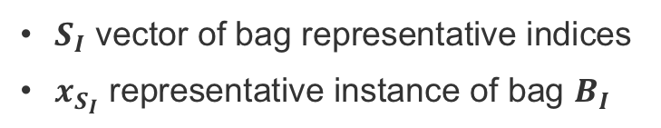
MIRSVM
Multi-Instance SVM using Bag Representatives
Primal
Dual
$S_{I}$ vector of bag representative indices
$x_{S_{I}}$ representative instance of bag $B_{I}$
G. Melki, A. Cano, and S. Ventura. “MIRSVM: Multi-Instance Support Vector Machine with Bag Representatives”. Pattern Recognition, vol. 79, 228-241, 2018.
Notes:
MIRSVM is based on the idea of selecting representative instances from both positive and negative bags which are used to find an unbiased, optimal separating hyperplane.
What we did was first reformulate the L1-SVM problem to optimize over bags rather than instances, as shown
A representative is iteratively chosen from each bag, and a new hyperplane is formed according to these new selected representatives until they converge.
Based on the SMI hypothesis, only one instance in a bag is required to be positive for the bag to adopt a positive label.
In other words, the most positive instance is chosen from each positive bag and the least negative instance is chosen from each negative bag (instances with the largest output value based on the current hyperplane)
These representatives are stored in SI
xsi ...
what we opted to derive and solve the dual problem using a QP solver
the following equations represent the calculation for the output and bias terms for the dual

Slide 24
MIRSVM
Multi-Instance SVM using Bag Representatives
G. Melki, A. Cano, and S. Ventura. “MIRSVM: Multi-Instance Support Vector Machine with Bag Representatives”. Pattern Recognition, vol. 79, 228-241, 2018.
Notes:
First we initialize the representatives randomly
then...

Slide 25
Comparison of MIRSVM and MISVM
G. Melki, A. Cano, and S. Ventura. “MIRSVM: Multi-Instance Support Vector Machine with Bag Representatives”. Pattern Recognition, vol. 79, 228-241, 2018.
Notes:
Here we have 2 comparison plots of the decision boundaries produced by MISVM and our MIRSVM on a toy dataset. The two methods were built on the same SVM hyper parameters.
From this plot, we can see the major differences in the final models. This is because of a couple of major differences.
Unlike MISVM, MIRSVM is designed to utilize and select representatives from positive and negative bags
MISVM allows multiple representatives to be chosen from negative bags and limits positive bag-representatives to be one, while MIRSVM allows for balanced bag-representative selection, where each bag is allowed one.
MISVM also uses a wrapper method to initialize the positive bag-representatives by taking the mean vector of the instances within each positive bag. This is an implicit assumption that the instances within the positive bags are all positive, whereas MIRSVM’s initialization procedure selects an instance from all bags at random, ensuring no noise is added by any wrapper techniques during initialization and no assumptions are made about the instances.
Due to the constraints on the representatives, MIRSVM produces sparser models while MISVM has the freedom to select as many negative support vectors as it needs and restricts the support vectors chosen from positive bags to be one.

Slide 26
Experimental Environment
Multi-Instance SVM using Bag Representatives
SVM Hyper-Parameters
Accuracy
Precision
Recall
Cohen’s Kappa Rate
Area Under ROC Curve
G. Melki, A. Cano, and S. Ventura. “MIRSVM: Multi-Instance Support Vector Machine with Bag Representatives”. Pattern Recognition, vol. 79, 228-241, 2018.
Notes:
The main aim of the experiments is to compare our contribution to other multi-instance support vector machines, contemporary multi-instance learners, and ensemble methods.
Datasets from Weka1 [38] and KEEL2 [2] dataset repositories.
Instance-level methods include MIOptimalBall, MIBoost, MISVM, MIDD, and MIWrapper.
Bag-level methods include MISMO, SimpleMI, miGraph, and TLC.
The ensemble-based bag-space methods, Bagging and Stacking, were also used.
These algorithms were chosen because they have shown considerable performance in learning multi-instance models, while also having their frameworks readily available for reproducing their results through MILK, the Multi-Instance Learning Kit, used in conjunction with the Weka framework.

Slide 27
Results
Multi-Instance SVM using Bag Representatives
G. Melki, A. Cano, and S. Ventura. “MIRSVM: Multi-Instance Support Vector Machine with Bag Representatives”. Pattern Recognition, vol. 79, 228-241, 2018.
Notes:
Bag-based and ensemble learners perform better than the instance-based and wrapper methods
MIRSVM performs better than MISVM for all datasets, indicating that using representatives from each bag and limiting the number of support vectors per negative bag improves the classification performance.
Instance-level classifiers and wrapper methods, such as MIBoost, MIWrapper, and SimpleMI perform the worst, This behavior emphasizes the importance of not making prior assumptions about the positive bags’ distributions.

Slide 28
Results
Multi-Instance SVM using Bag Representatives
G. Melki, A. Cano, and S. Ventura. “MIRSVM: Multi-Instance Support Vector Machine with Bag Representatives”. Pattern Recognition, vol. 79, 228-241, 2018.
Notes:
MIRSVM has the fastest run time and is ranked second.
MIRSVM shows very good scalability considering the number of features, such as in the webmining dataset which comprises of 5863 attributes.
It is important to note that quadratic programming solvers are not the most efficient tools for solving optimization problems in terms of run time, and yet MIRSVM still is shown to perform competitively against the current widely used algorithms. The scalability of MIRSVM is founded on the speedy rate of bag-representative convergence. This is shown in Figure 4.2 in my proposal document.
SimpleMI achieves the highest rank and competitive run times because, rather than use the instances in each bag to train a model, it takes the mean value of the instances in a bag and uses that for training. Even though SimpleMI has fast run-times, its performance over the previous metrics has been shown to be random and not as effective as the bag-level methods.

Slide 29
MIL Conclusions
Multi-Instance SVM using Bag Representatives
The experimental study showed the better performance of MIRSVM compared with existing multi-instance support vector machines, traditional multi-instance learners, as well as ensemble methods.
The results were compared and further validated using statistical analysis:
bag-level based and ensemble learners had the best performance
instance-level based learners performed poorly in comparison or were deemed as strongly biased and unstable classifiers
MIRSVM performs statistically better, neither compromising accuracy nor run-time while displaying a robust performance across all datasets.
G. Melki, A. Cano, and S. Ventura. “MIRSVM: Multi-Instance Support Vector Machine with Bag Representatives”. Pattern Recognition, vol. 79, 228-241, 2018.

Slide 30
Conclusions

Slide 31
Conclusions
Conclusions
Multiple-Target Regression
Three unique approaches were proposed:
The baseline problem transformation SVR
An ensemble of randomly generated chains using SVR, named SVRRC
Maximally correlated chained model, SVRCC
SVRCC provided the best results among the contributions and against the methods compared.
Multiple-Instance Classification
A novel MI bag-level formulation and algorithm, MIRSVM, with a bag-representative selector, are proposed.
MIRSVM outperformed current contemporary SVM multi-instance algorithms, as well as other algorithms of different classes.
Notes:
Multiple-Target Regression
Three unique approaches were proposed: the baseline problem transformation SVR, an ensemble of randomly generated chains using this base model SVRRC, and a maximally correlated chained model SVRCC.
SVRCC was shown to capture target correlations accurately, providing the best results among the contributions and against the methods compared.
Multiple-Instance Classification
A novel multiple-instance bag-level formulation and algorithm, dubbed MIRSVM, with a bag-representative selector, are proposed.
MIRSVM outperformed current contemporary SVM multi-instance algorithms, as well as other algorithms of different classes.

Slide 32
Future Work
Notes:
Even though the proposals outperformed existing popular algorithms in each learning paradigm, the two popular and standard solvers used for our contributions have some disadvantages:
Although SMO provides an exact solution to the SVM QP problem, its performance is highly dependent on the SVM hyperparameters.
MATLAB’s QP solver is notoriously dependent on the size and complexity of the data.
To address these problems, the future work of this dissertation first aims to deal with these limitations without sacrificing accuracy for scalability with respect to large-scale problems, while maintaining applicability to small and medium sized datasets.

Slide 33
Future Work
Future Work
OnLine Learning Algorithm using Worst Violators:
Motivation:
Eliminate parametrization included with most online methods
Reduce training time & keep memory consumption minimal
Maintain competitive accuracy against popular methods
Involves:
Innovative iterative procedure
New support vector identification method
Unique stopping criteria
Application:
Traditional supervised learning
Data Stream Learning problem
Notes:
What we would like to do is create an SVM within the online learning setting while remedying some of the hurdles of current online/stochastic learning algorithms.
This will consist of:
Devising a unique iterative procedure, as well as a novel method for identifying support vectors. Rather than randomly iterating over the data samples, the proposal will aim to reduce training time by selecting and updating the samples that are most incorrectly classified with respect to the current decision hyperplane.
Designing a novel stopping criteria by utilizing this support vector identification method. This aims to eliminate the added parameterization that is included with most online methods: the number of iterations performed by the algorithm needs to be set in advance.
Finally, we aim to apply, experiment and analyze the performance of the newly proposed method to a popular new online paradigm, learning from streaming data, where data is not persistent, rather it is transient over time. This challenging setting will test the new contribution’s performance on not only a dynamic data representation, but also on how efficiently computational resources are being used when learning is constrained over time.

Slide 34
Publications
[1] G. Melki, A. Cano, V. Kecman, S. Ventura. “Multi-target support vector regression via correlation regressor chains”. Information Sciences, vol. 415-416, pp. 53–69, 2017.
Impact Factor: 4.832
Quartile: Q1
[2] G. Melki, A. Cano, and S. Ventura. “MIRSVM: Multi-Instance Support Vector Ma- chine with Bag Representatives”. Pattern Recognition, vol. 79, pp. 228-241, 2018.
Impact Factor: 4.582
Quartile: Q1
Notes:
This concludes my presentation. More details on implementation, design, experimental environment, and such can be found in the following publications.
Thank you again for your attention.
Why SVMs:
One specific benefit that these models have over SVMs is that their size is fixed: they are parametric models, while SVMs are non-parametric. That is, in an ANN you have a bunch of hidden layers with sizes h₁ through h_{n} depending on the number of features, plus bias parameters, and those make up your model.
By contrast, an SVM (at least a kernelized one) consists of a set of support vectors, selected from the training set, with a weight for each. In the worst case, the number of support vectors is exactly the number of training samples (though that mainly occurs with small training sets or in degenerate cases) and in general its model size scales linearly. In natural language processing, SVM classifiers with tens of thousands of support vectors, each having hundreds of thousands of features, is not unheard of.
Also, online training of FF nets is very simple compared to online SVM fitting, and predicting can be quite a bit faster.
EDIT: all of the above pertains to the general case of kernelized SVMs. Linear SVM are a special case in that they are parametric and allow online learning with simple algorithms such as stochastic gradient descent.

